Slide 1
Apache Maven
Maven is a powerful project management tool that is based on POM (project object model). It is used for project build, dependency, and documentation. It simplifies the build process like ANT. But it is too much more advanced than ANT. In short terms we can tell maven is a tool that can be used for building and managing any Java-based project. maven makes the day-to-day work of Java developers easier and generally helps with the comprehension of any Java-based project.

Slide 2

What maven does do?
Maven does a lot of helpful tasks like:
We can easily build a project using maven.
We can add jars and other dependencies of the project easily using the help of maven.
Maven provides project information (log document, dependency list, unit test reports, etc.)
Maven is very helpful for a project while updating the central repository of JARs and other dependencies.
With the help of Maven, we can build any number of projects into output types like the JAR, WAR, etc without doing any scripting.
Using maven we can easily integrate our project with a source control systems (such as Subversion or Git).
Maven also helps in managing the project’s build lifecycle, including tasks like compiling, testing, packaging, and deploying the code.

Slide 3

Maven provides a standard project structure, making it easy for developers to understand the layout of the project and locate specific files.
Maven supports multi-module projects, allowing developers to work on multiple related projects simultaneously and manage their dependencies efficiently.
Maven plugins can be used to add additional functionality to the build process, such as code coverage analysis, static code analysis, and more.
Maven is highly customizable, allowing developers to configure the build process to meet their specific needs and requirements.
Maven simplifies the process of managing project dependencies, ensuring that the correct versions of libraries and frameworks are used throughout the project.

Slide 4
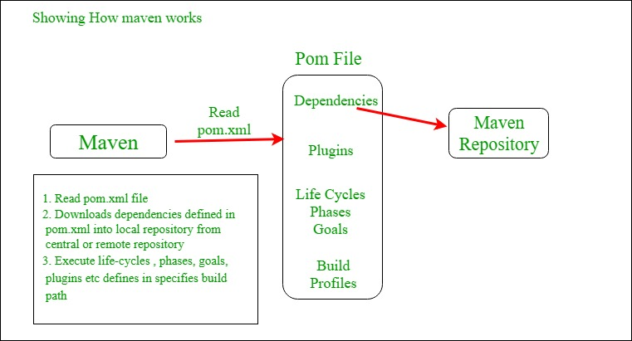
THANK YOU

Slide 5

Core Concepts of Maven:
POM Files: Project Object Model(POM) Files are XML file that contains information related to the project and configuration information such as dependencies, source directory, plugin, goals etc. used by Maven to build the project. When you should execute a maven command you give maven a POM file to execute the commands. Maven reads pom.xml file to accomplish its configuration and operations.
Dependencies and Repositories: Dependencies are external Java libraries required for Project and repositories are directories of packaged JAR files. The local repository is just a directory on your machine’s hard drive. If the dependencies are not found in the local Maven repository, Maven downloads them from a central Maven repository and puts them in your local repository.

Slide 6
Build Life Cycles, Phases, and Goals: A build life cycle consists of a sequence of build phases, and each build phase consists of a sequence of goals. Maven command is the name of a build lifecycle, phase, or goal. If a lifecycle is requested executed by giving the maven command, all build phases in that life cycle are executed also. If a build phase is requested executed, all build phases before it in the defined sequence are executed too.
Build Profiles: Build profiles a set of configuration values that allows you to build your project using different configurations. For example, you may need to build your project for your local computer, for development and test. To enable different builds you can add different build profiles to your POM files using its profiles elements which are triggered in a variety of ways.
Build Plugins: Build plugins are used to perform a specific goal. you can add a plugin to the POM file. Maven has some standard plugins you can use, and you can also implement your own in Java.

Slide 7

Apache Ant (Another Neat Tool) is an open source project started by Apache Software Foundation. Ant is a Java library and a software tool used for automate software build processes such as compile, run, test and assemble Java application. It is designed and developed by Apache Software Foundation and initially released on 19 July 2000.
It is a better alternate of Make build tool of Unix. Ant is written in Java and require JVM to build the Java projects.

Slide 8

Difference between Maven and Ant
Maven : Maven is a powerful project management tool based on the Project Object Model. It helps in managing project builds, documentation, dependency, releases, etc.
Ant :Ant is a command-line toolbox without any coding conventions or project structures, making it flexible and more manageable to use. It is most commonly used to build Java applications.

Slide 9
 | Maven | Ant
Definition | It is a framework based on the concept of POM. | It is a Java library and command-line toolbox.
Convention | It has built-in conventions to place source code, compiled code, etc. | It does not have any formal conventions.
Project structure Info | It does not require information about the project structure to be provided in the pom.xml file. | It requires information on the project structure to be provided in the build.xml file.
Lifecycle | It has a lifecycle. | It does not have a lifecycle.
Nature | It is declarative in nature (only source should be present in the default directory). | It is procedural in nature (manually tell exactly what to do and when to do it).
Type | It is primarily a project management tool. | It is primarily a project management tool.
Dependency | It can self download the dependencies from a central repository for building projects. | It has no built-in support for dependency management.
Reusability | It consists of reusable plugins. | It consists of scripts that are not reusable.
Preference | It is less preferred. | It is more preferred.
Complexity | It is more complex. | It is simple and reliable.
Flexibility | It is less flexible and maintainable. | It is more flexible and maintainable.
Differences between Maven and Ant :

Slide 10
Reports | It creates reports. | It does not create reports.
Interface | It provides common interface. | It does not provide common interface.
Naming Conventions | It has standard naming conventions. | It does not have standard naming conventions.
Popularity | It is more popular in users. | It is less popular in users.
Scripts | Scripts are not complicated. | Scripts are complicated.
Ease of Use | It is easy to use for developers. | It is complex to use at first for developers.
Documentation | It has more documentation. | It has less documentation.
Reliability | It is not reliable. | It is more reliable than Maven.
Conflicts | Conflicts are not handled for the same library. | Conflicts are handled for the same library.
Reports | It creates reports. | It does not create reports.
Interface | It provides common interface. | It does not provide common interface.
Naming Conventions | It has standard naming conventions. | It does not have standard naming conventions.
Differences between Maven and Ant :

